Slide 1
Embracing Digital Art
haoranli
jinhaoGuo
XiLong

Slide 2

An elephant with a wagging Nose!
Parameter:parameters = [50 - 30j, 18 + 8j, 12 - 10j, -14 - 60j, 20 + 20j]

Slide 3

A Butterfly with two circle wings!
pARAMeter: parameters = [50 - 50j, 30 + 10j, 5 - 2j, -5 - 6j, 20 + 20j]

Slide 4
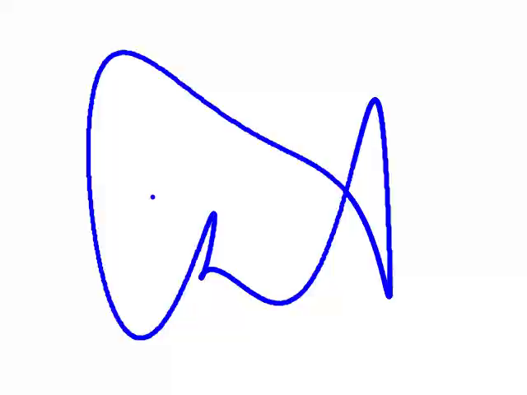
A tail-Wagging Fish

Slide 5

A Peanut Shooter
parameters = [30 - 10j, 20 + 20j, 40 + 10j, 20 - 50j, -40 + 10j]

Slide 6

I dont know whats this （may be a jellyfish/）
parameters = [32 + -19j, 18 + 12j, 11 + 29j, -14 - 60j, 26 + 26j]

Slide 7

Squiggle Shark
parameters = [1 - 2j, 9 + 9j, 1 - 2j, 9 + 9j, 0 + 0j]

Slide 8
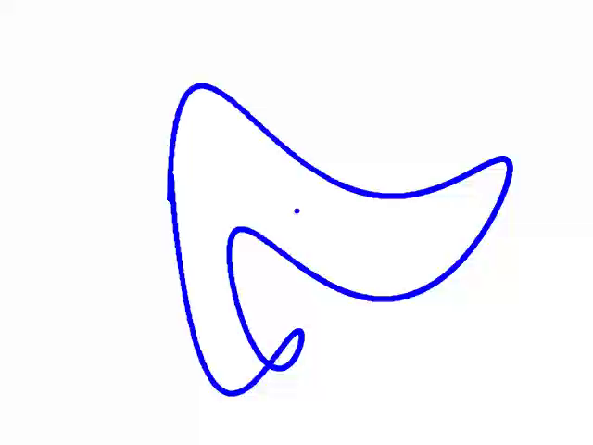
A Wiggly Whale
parameters = [50 - 10j, 15 + 30j, -5 - 15j, -20 - 40j, 5 + 15j]

Slide 9

A slinky, wavy Dragon!
parameters = [50 - 30j, 18 + 8j, 12 - 10j, -14 - 60j, 20 + 20j]

Slide 10

A Chewing Crocodile
parameters = [35 - 20j, 25 + 30j, -15 - 25j, -10 - 50j, 15 + 15j]

Slide 11
Briefly explain coordinates
The Fourier coordinate expansion used to create the elephant and other shapes (like the sperm whale, swan, etc.) is related. The technique decomposes 2D shapes into sums of sine and cosine terms, similar to how polar coordinates represent points via radius and angle. For example, the elephant's x and y coordinates are expressed as Fourier series:
x(t)=50sin(t)+18sin(2t)+12cos(3t)−14cos(5t)
y(t)=−60cos(t)−30sin(t)+8sin(2t)−10sin(3t)
This harmonic decomposition mirrors polar representations but uses complex parameters to compactly encode amplitudes for sine/cosine terms. The trunk's movement is animated by modulating them with sin(i), leading in different angles shown onthe pictures.

Slide 12
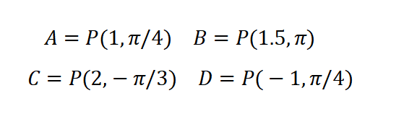
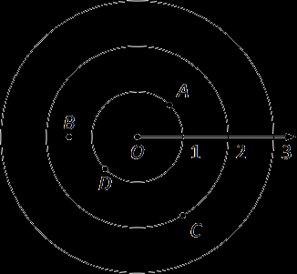
Polar Coordinate
In polar coordinate system, to find A, we can go out 1 unit along the initial ray (putting you on the inner circle shown on the grid), then rotate counter-clockwise π/4 radians.
Alternatively, we can change the order as well. i·e·
, think about the ray from Othat forms an angle of π/4
with the initial ray, then move out 1 unit along this ray.
Similarily, we can locate the B, C, D as well.

Slide 13
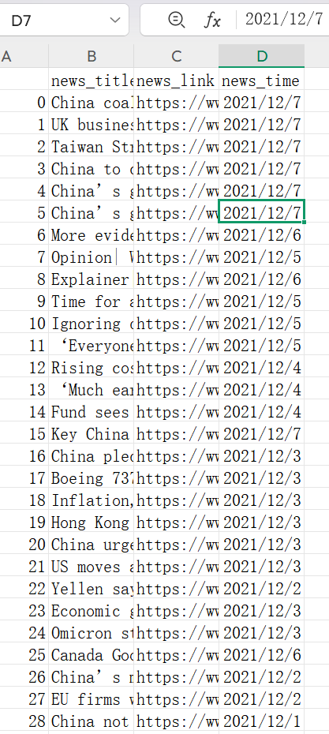
Data we scraped from web www.scmp.com, including news_title, news_link, news_text, news_time.
1.Imports libraries (requests, BeautifulSoup, datetime, csv, etc.)
Defines user_agent_list to rotate for request headers
2.Content Retrieval:
The get_page_content() function makes HTTP requests with:
Random delays (1-3 s) between requests
3 retry attempts for failed requests
10-second timeout
Randomized user agents
3.Web Scraping:
Targets SCMP's China Economy news page
Finds all news sections using CSS class selectors
For each news item:
Extracts title, link, and description text
Parses publication date (handling multiple formats)
Stores data in a dictionary with standardized date format
4.Data Export:
We write collected data to"news_data.csv" with four columns
Header row and one row per news item
5.For output, wePrint success message with record count
we showed 5 sample records for verification
Includes comprehensive error handling with:
Network failure detection
Parsing error fallbacks
Troubleshooting suggestions

Slide 14
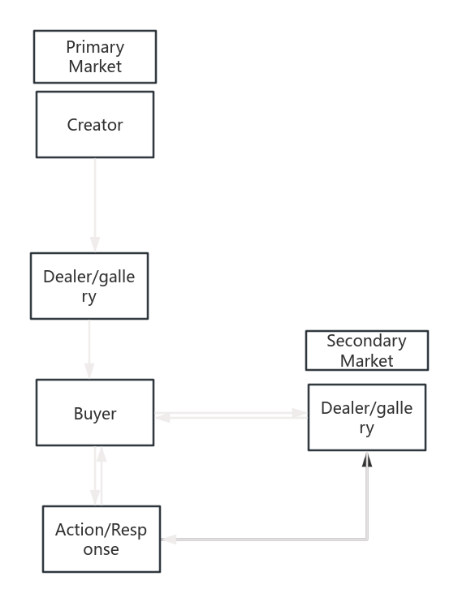
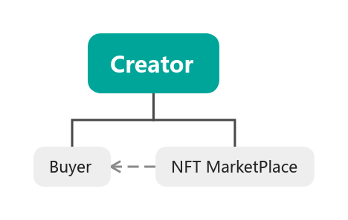
Thanks for watching!
The mindmap of Selling Process in Primary(Second) Market.

